Slide 1
Eye Tracking and Gaze Tracking Software
A Project Proposal Presentation
by Somesh Bagadiya

Slide 2
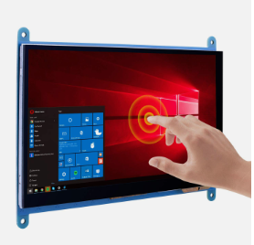
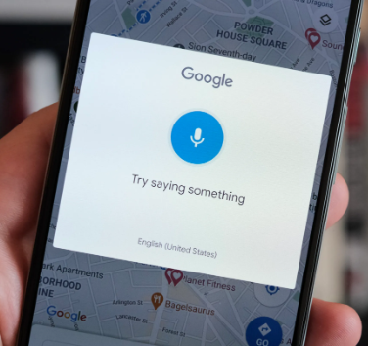
What are the ways we give inputs to a computer?
Mouse and Keyboard
Touch input
Voice Input
??
Notes:
4th one can be using your eyes.
Probably the greatest jump in the input methods would be brain-computer interface similar to Neuralink’s implementation.

Slide 3
Why you need eyes to give input to the computer?
The eyes serve as the primary means through which we can receive input from our environment and subsequently respond as needed.
A common requirement is hand-eye coordination for most of the input methods.
We can overcome this gap by providing the computer with inputs directly via your eyes.
Notes:
Eye are primary ways we get input from the environment so it would be natural to interact with computer using your eyes.
We still use eyes while using other sources of input, therefore we can bridge this gap by using eyes directly for inputs to the computer. Thus I want to build a software for eye tracking

Slide 4
What are the advantages of using eyes as a source of input
Natural and Intuitive Interaction
Hands-Free Operation
Precision and Speed
Enhanced Productivity
Notes:
Our main ways to interact with the environment are eyes, so its natural to use Eyes as a input source.
You can operate on your tech without the need for physical touch, mouse, or keyboard input. This is particularly valuable in situations where hands-free operation is crucial.
This will help you reduce the latency between thinking and then implementing, you have to just look at a thing and it will be done.
It can be used as a assistive input to your existing inputs which may increase the convenience and speed.

Slide 5
Disadvantages of Eye Tracking
A major concern is privacy, no one wants a camera, pointed at themselves day and night, recording them.
Limitations of hardware, you might have to get close enough to the system so that it can track your eyes.
Computational cost, it is computationally heavier compared to using a touch or mouse and keyboard.

Slide 6
Real world day to day applications
Can you guys think of any real world day to day applications?
Notes:
I can think of many, Netflix – When you are cozy in your bed and you want to press on the next episode button or skip intro button, you will fiddle around to look for a remote or your phone to click on the button. This would have been easily done by your eyes.
Whenever you look away or walk away from you’re your pc it should auto lock it and auto unlock it.

Slide 7
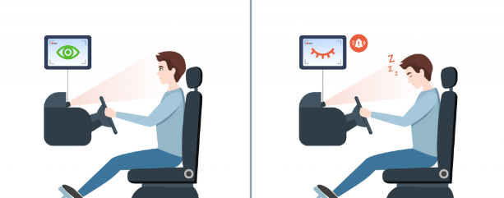
Applications of Eye Tracking Technology
There are many applications for Eye Tracking but I’ll be focusing on the below mentioned applications.
- Drowsiness Detection
- Real-time Attention Monitoring
Notes:
Eye tracking technology is harnessed to recognize early signs of drowsiness, providing an extra layer of safety for individuals engaged in activities that demand vigilance, such as driving or operating heavy machinery.
Continuous monitoring of eye movement patterns allows for the immediate assessment of user attention levels. This feature can be applied in various domains, from e-learning to UX design, ensuring sustained user engagement.

Slide 8
Implementation of Drowsiness Detection.
Built using dlib's state-of-the-art face recognition built with deep learning.
OpenCV
Notes:
99.38% accuracy in detecting faces
Dlib's face recognition module is built on top of the Dlib C++ library and provides face detection and recognition capabilities.
The face recognition module uses a pre-trained model for face detection and a pre-trained model for face recognition.
Dlib's face detection model is based on a Histogram of Oriented Gradients (HOG) feature combined with a linear classifier.
Dlib can also provide facial landmarks (68-point landmarks) that represent key points on the face, such as eyes, nose, and mouth.
While Dlib itself is written in C++, there is a Python wrapper that allows developers to use the face recognition functionality in a Python environment.
Open CV because It provides a comprehensive set of tools for image and video analysis, processing, and computer vision tasks.

Slide 9
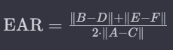
What is Eye Aspect Ratio?
The EAR is calculated using the following formula:
Notes:
A: Inner corner of the eye (leftmost point)
B: Top of the eye
C: Outer corner of the eye (rightmost point)
D: Bottom of the eye
E: Additional point on the top eyelid
F: Additional point on the bottom eyelid
||B-D||: The distance between the top (B) and bottom (D) landmarks of the eye.
∥E−F∥: An additional measure to capture the height of the closed eye. It is the distance between two points on the top (E) and bottom (F) eyelids.
||A−C∥: The distance between the inner (A) and outer (C) corners of the eye.
Interpreting the EAR:
When the eye is open, the EAR is relatively high.
When the eye is closing or closed, the EAR decreases.
Blinking typically involves a significant drop in EAR.

Slide 10
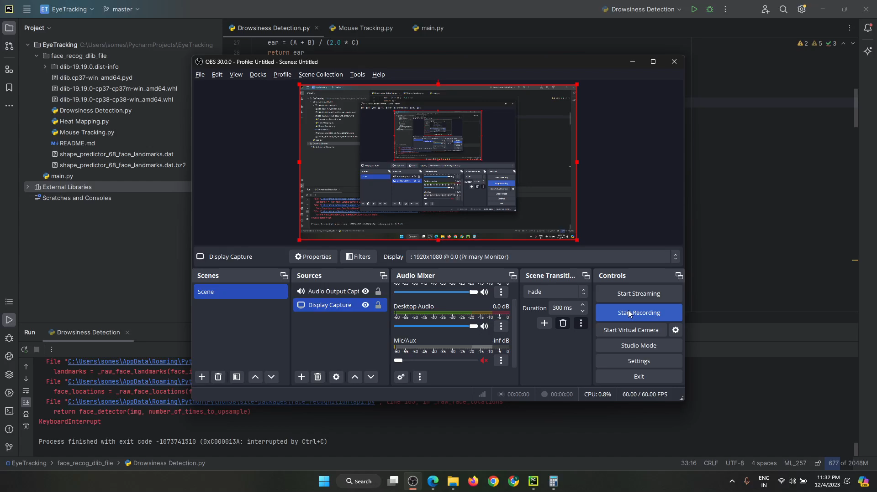
Demo

Slide 11
Difference between eye tracking and gaze tracking
Eye Tracking: Eye tracking primarily monitors and records the movement of the eye itself, tracking its position and motion. It aims to understand how the eye moves, where it looks, and how it fixates on specific points of interest.
Gaze tracking: Gaze tracking goes beyond the eye's motion and specifically concentrates on determining where the user is looking or fixating their gaze within a visual field. It pinpoints the exact point the user is focusing on.

Slide 12
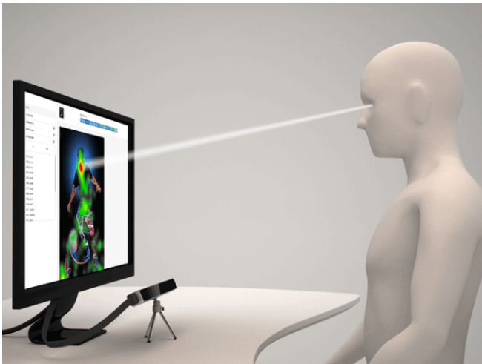
Gaze Tracking Applications
- Mouse Control
- Dynamic Heat Mapping
Notes:
Users can effortlessly control their computer cursor with natural eye movements, streamlining interactions with digital interfaces and improving accessibility.
Gaze tracking data is transformed into visual heat maps, revealing where users concentrate their visual attention. This aids in optimizing user interfaces, web content, and marketing strategies.

Slide 13
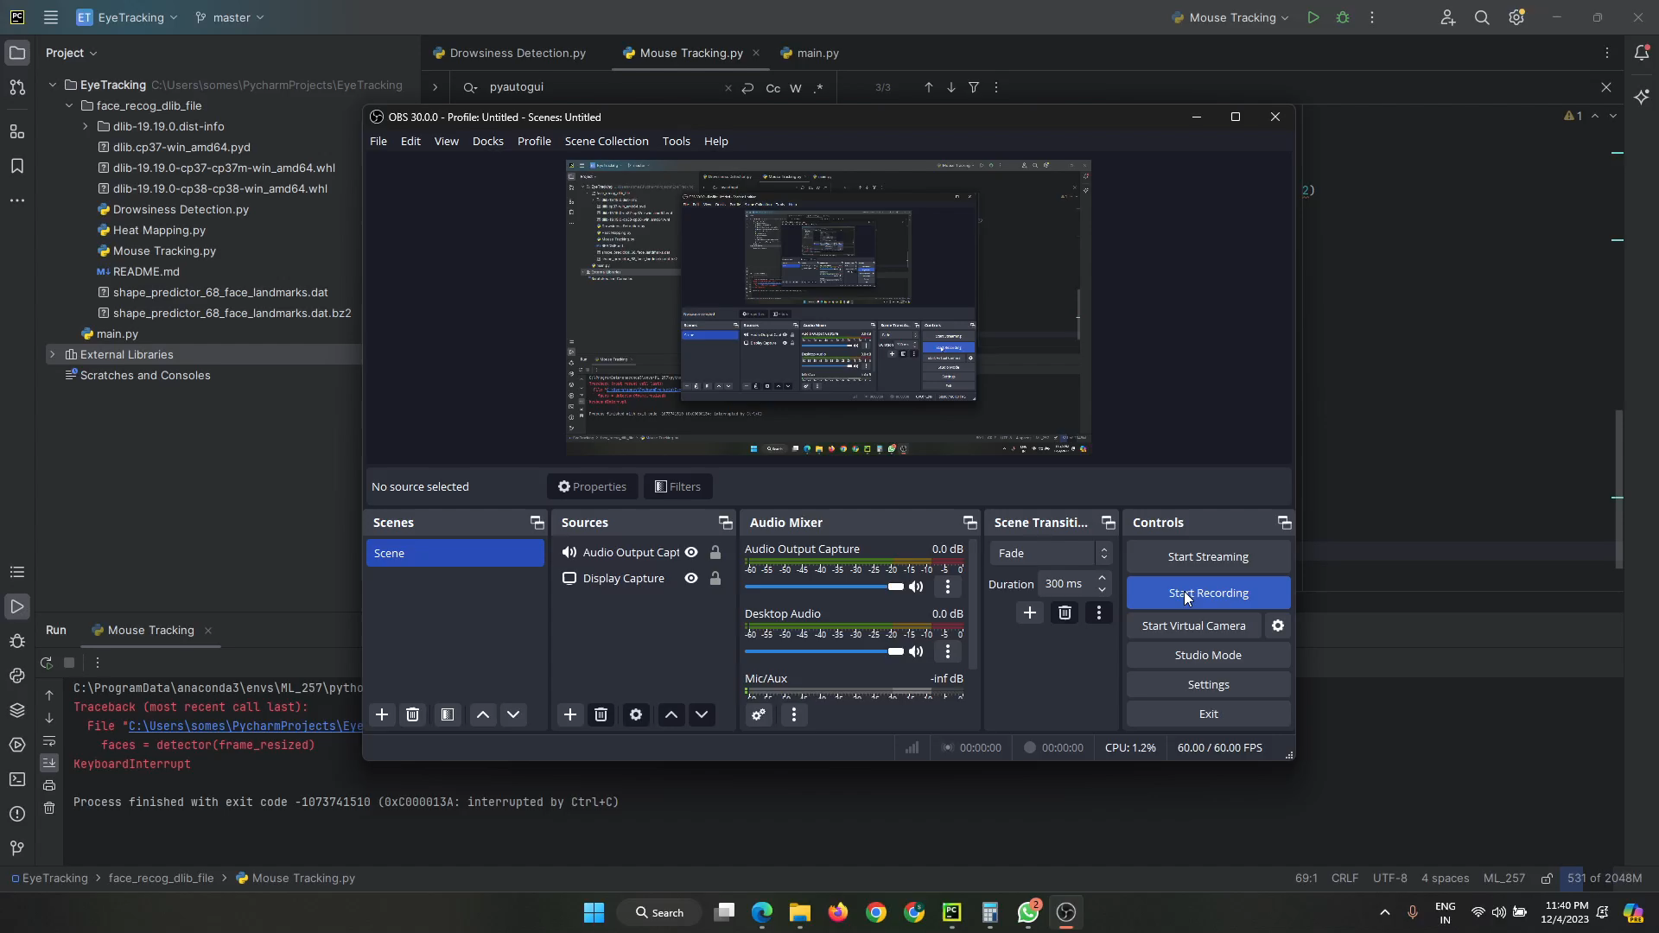
Demo for Mouse Control

Slide 14
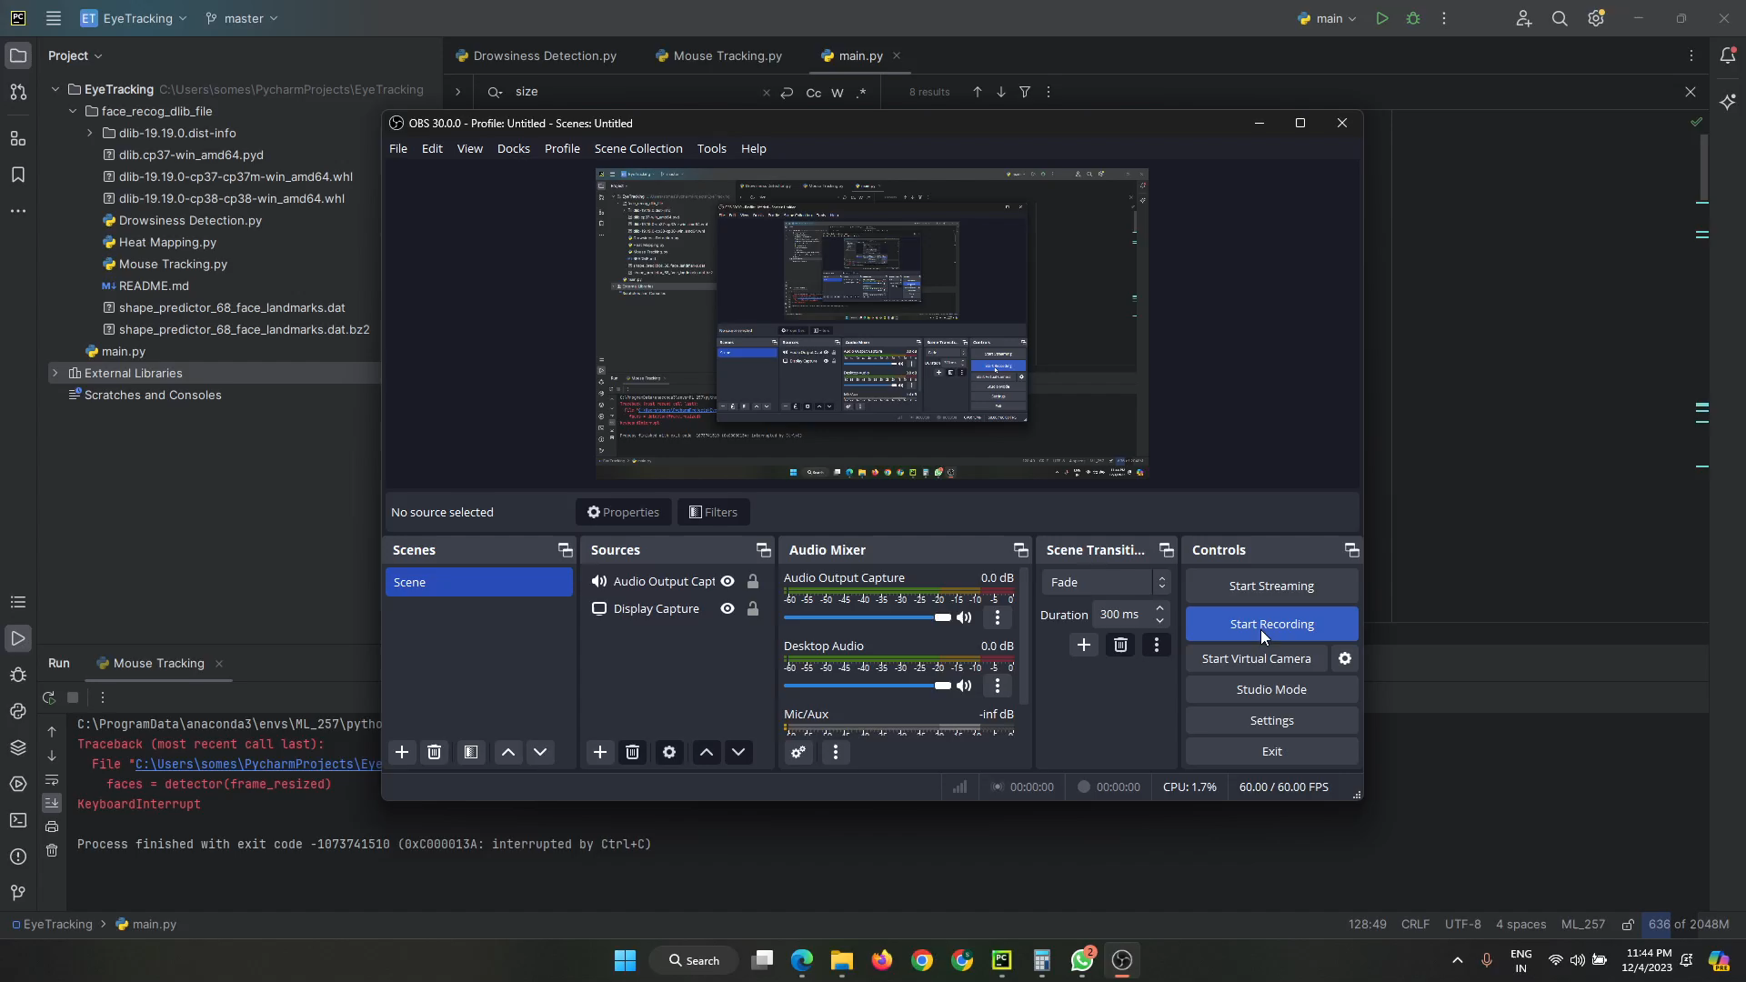
Demo for Heat Mapping

Slide 15
Limitations
Speed
Resource Intensive
Calibration Requirement
Glasses and Occlusions
Notes:
Speed: The speed of facial landmark detection and tracking can be a limiting factor.
Resource Intensive: Real-time eye tracking requires continuous processing, which can be resource-intensive.
Calibration Requirements: For precise eye tracking, calibration is often required to map gaze direction accurately.
Glasses and Occlusions: Eyeglasses or other facial occlusions can affect the accuracy of facial landmark detection, especially landmarks related to the eyes.

Slide 16
Future Scope
Improve the accuracy of the Heat Mapping
Improve Speed

Slide 17
Thank You

